Slide 1
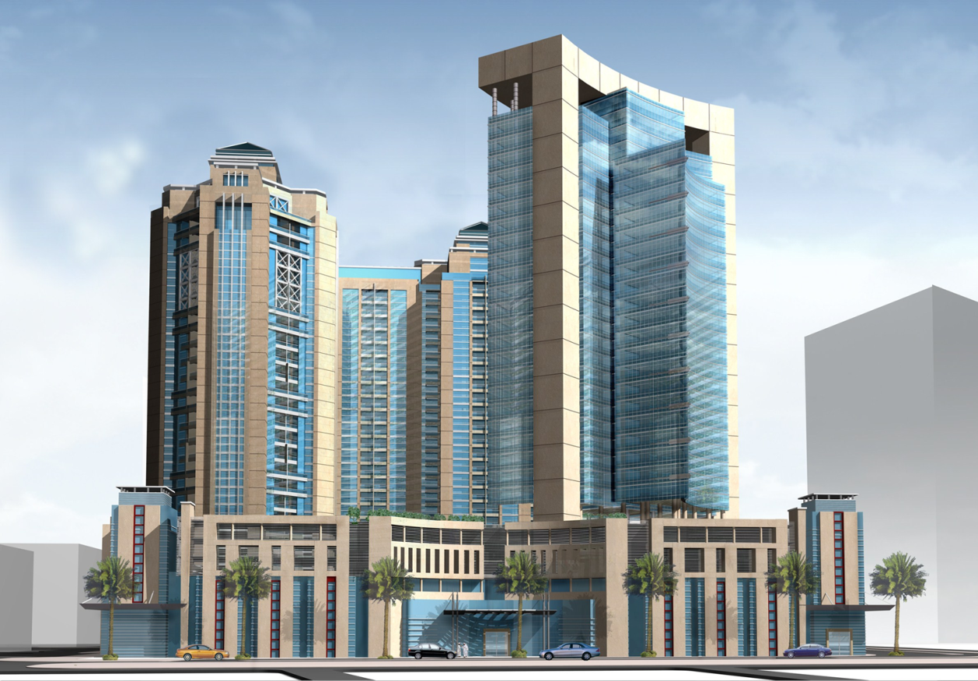
ARCHITECTURAL ENGINEERING SENIOR THESIS PRESENTATION
HAMAD ALRAHMANI
Fall 2010
Pennsylvania State University
MURUR MIXED-USE COMPLEX
AJMAN, UNITED ARAB EMIRATES

Slide 2
PRESENTATION OUTLINE
MURUR MIXED-USE COMPLEX
HAMAD ALRAHMANI
Project Overview
Analysis 1: Photovoltaic Panels
Goals and method
System design
Energy produced
Cost and schedule
Payback
Conclusion
Analysis 2: Solar Shading
Goals and method
System design
Energy saved
Cost comparison
Payback comparison
Conclusion
Analysis 3: Prefabrication
Goals and method
Truland Industries
Hospital Example
Items prefabricated
Prefabrication savings
Conclusion
Analyses Conclusions and Recommendations
Acknowledgments

Slide 3
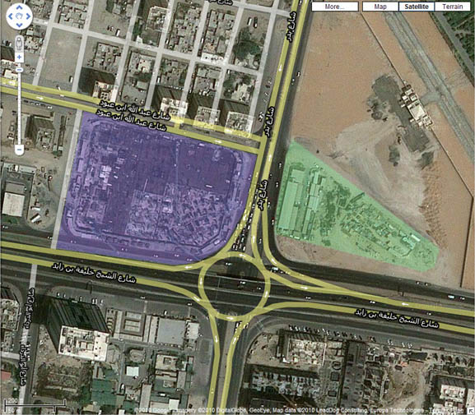
PROJECT OVERVIEW
MURUR MIXED-USE COMPLEX
HAMAD ALRAHMANI
Project Location: In the heart of Ajman City, United Arab Emirates
Size: 2,300,000 Square Feet
Project Components: 3-story Shopping Mall,
22-story Residential Tower
26-story Office Tower
5-Story Parking
Construction Schedule: June / 9 / 2008
November / 8 / 2011
Project Cost Estimate: $164.4 Million
Delivery Method: Design-Build
Google maps view of the project location

Slide 4
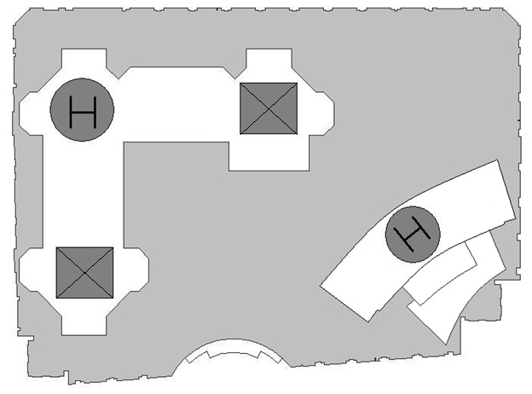
PROJECT OVERVIEW
MURUR MIXED-USE COMPLEX
HAMAD ALRAHMANI
Project Layout:
3 floors Underground Parking
3 floors Shopping Mall
2 floors Upper lever Parking
20 floors + Penthouse Residential Tower
26 floors Office Tower
Project Layout

Slide 5
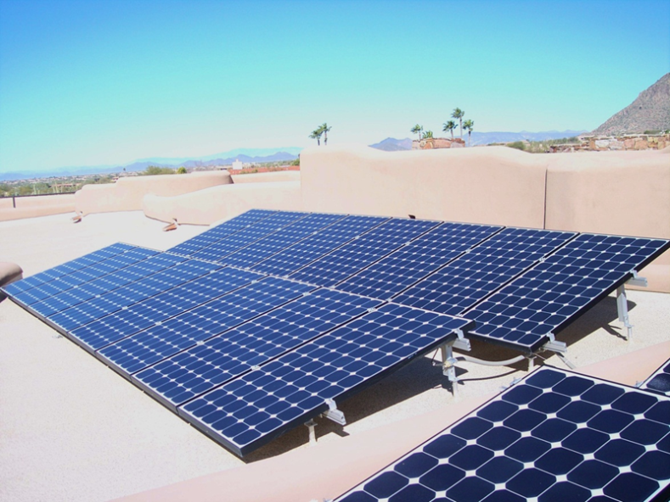
PHOTOVOLTAIC PANELS
MURUR MIXED-USE COMPLEX
HAMAD ALRAHMANI
Analysis 1: Photovoltaic Panels
Analyze the feasibility of a PV solar system by:
Finding the best products
Researching sunlight nature in the UAE
Determining the energy produced by the system
Calculating the cost of the system
Determining the payback period

Slide 6
PHOTOVOLTAIC PANELS
MURUR MIXED-USE COMPLEX
HAMAD ALRAHMANI
Product:
Yingli’s YL225P-29b Solar Panel
Each panel is 17.6 sq ft
System Components:
(240) x 225W Panels
(15) x 2,900W Inverters
Wiring and Mounting Equipment

Slide 7
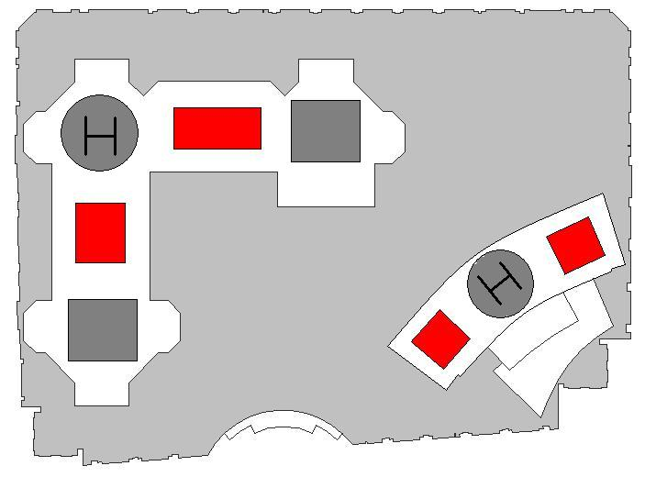
PHOTOVOLTAIC PANELS
MURUR MIXED-USE COMPLEX
HAMAD ALRAHMANI
Location of the panels:
Solar panels are divided into 4 groups
They will be installed on the tower’s rooftops
Panels Orientation:
Solar panels will be facing south
They will be tilted 30° south
Panels’ locations shown in red

Slide 8
PHOTOVOLTAIC PANELS
MURUR MIXED-USE COMPLEX
HAMAD ALRAHMANI
Energy Production:
Solar radiation average in the UAE is 6.3 KWh/m² per day
(240) 225W panels will produce about 122,500 KWh per year
The energy tied to the grid is less than 122,500 KWh since the energy goes through inverters before it is connected to the system
The total energy tied to the system is about 98,600 KWh per year
Quantity and Period of use | Power Output
1 Panel | 225 W
240 Panels system | 54 KW
System x 6.3 kWh/m² per day | 340.2 KWh
System x 30 days | 10,206 KWh
System x 12 months | 122,472 KWh
Quantity and Period of use | Power Output
1 inverter | 2,900 W
15 inverters | 43.5 kW
System x 6.3 kWh/m² per day | 274 kWh
System x 30 days | 8,222 kWh
System x 12 months | 98,658 kWh
PV Panels Power Output
Solar System Power Output

Slide 9
PHOTOVOLTAIC PANELS
MURUR MIXED-USE COMPLEX
HAMAD ALRAHMANI
System Cost:
The PV solar system total cost is $233,295
There are no government incentives or any kind of credit for green and energy efficient products in the UAE
Schedule:
The schedule of the project will not be affected by this addition
Installing the system will be done by a specialized crew and will not interfere with the original project plan
Description | Cost
12 x (20 Yingli solar panels pallet) | $124,200
15 x PVI 3000-208V inverter | $28,095
Mounting equipment at ($0.50 per Watt) | $27,000
Installation cost at ($1 per Watt) | $54,000
Total cost of the system | $233,295

Slide 10
PHOTOVOLTAIC PANELS
MURUR MIXED-USE COMPLEX
HAMAD ALRAHMANI
System Payback:
Discounted Payback Method was used to determine the payback period for the solar system
4% is the interest rate assumed for the calculation
The system will payback it’s cost after 75 years
Number of Years | Value of Savings at Specific Single Year | Total Value of Savings up to the Specific Year
1 | $9,486.346 | $9,486.346
5 | $8,108.968 | $43,920.79
10 | $6,664.981 | $80,020.48
25 | $3,700.827 | $154,124.3
50 | $1,388.243 | $211,938.9
75 | $520.7531 | $233,626.2
100 | $195.3432 | $241,761.4

Slide 11
PHOTOVOLTAIC PANELS
MURUR MIXED-USE COMPLEX
HAMAD ALRAHMANI
Conslusion:
The UAE is one of the best locations for PV systems
The system can produce good amount of energy, but a payback period of 75 years is not acceptable

Slide 12
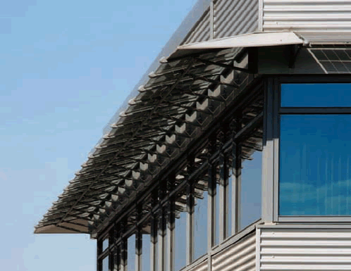
SOLAR SHADING
MURUR MIXED-USE COMPLEX
HAMAD ALRAHMANI
Analysis 2: Solar Shading
Determine the effectiveness of solar louvers by:
Finding the best products
Finding the best location on the project
Calculating windows’ heat gain
Calculating energy savings
Calculating cost and payback
Comparing the 2 products

Slide 13
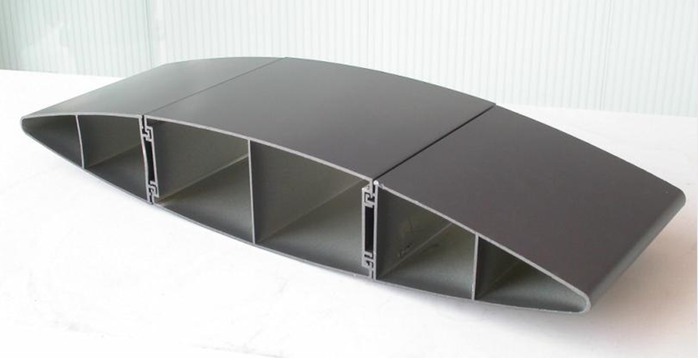
SOLAR SHADING
MURUR MIXED-USE COMPLEX
HAMAD ALRAHMANI
Product:
Nysan Aerofoil Aluminum Louvers
18 inch VS. 24 inch louvers

Slide 14
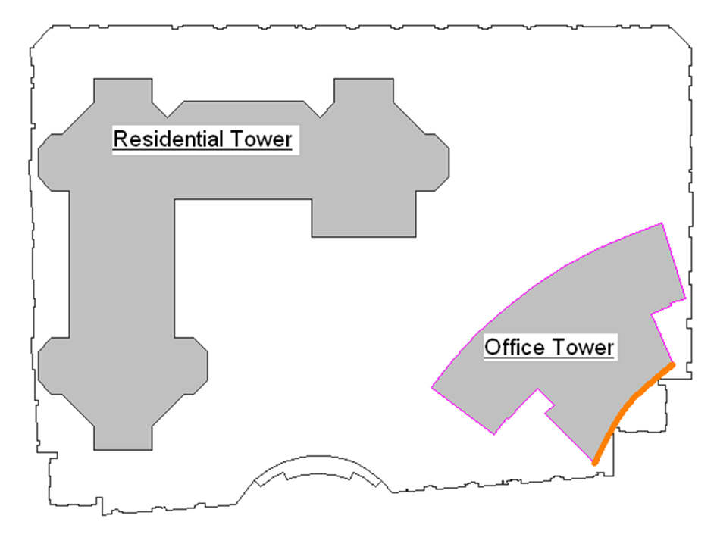
SOLAR SHADING
MURUR MIXED-USE COMPLEX
HAMAD ALRAHMANI
Location of Louvers:
Office tower is all glass, so the louvers are most effective on it
UAE is in the northern hemisphere, so the sun is always south
Best location of louvers: Office tower south façade

Slide 15
SOLAR SHADING
MURUR MIXED-USE COMPLEX
HAMAD ALRAHMANI
Window Heat Gain:
There is 17,108 ft² of glass windows on the south façade where the louvers are to be installed
Those windows gain
3.4 Billion BTUs per year
Month | Solar Heat Gain (BTUs)
January | 472,659,824
February | 361,594,688
March | 266,508,428
April | 145,503,540
May | 122,082,688
June | 119,294,084
July | 123,092,060
August | 153,219,248
September | 269,143,056
October | 414,543,948
November | 471,017,456
December | 495,516,112
Total BTUs per year | 3,414,175,132

Slide 16
SOLAR SHADING
MURUR MIXED-USE COMPLEX
HAMAD ALRAHMANI
Energy Savings:
Month | BTUs Saved by 24 in Louvers | BTUs Saved by 18 in Louvers
January | 56,719,179 | 40,412,415
February | 84,613,157 | 60,169,356
March | 135,919,298 | 101,539,711
April | 123,387,002 | 100,397,442
May | 122,082,688 | 122,082,688
June | 119,294,084 | 119,294,084
July | 123,092,060 | 123,092,060
August | 153,219,248 | 138,479,556
September | 151,796,683 | 127,735,294
October | 143,846,750 | 100,278,181
November | 69,710,583 | 49,268,425
December | 50,542,643 | 36,073,573
Total | 1,334,223,375 | 1,118,822,785

Slide 17
SOLAR SHADING
MURUR MIXED-USE COMPLEX
HAMAD ALRAHMANI
Energy Savings:
- The 24 inch louver system saves about 1.33 Billion BTUs per year
1.33 Billion BTUs = 391,000 KWh = $35,183 per year
- The 18 inch louver system saves about 1.12 Billion BTUs per year
1.12 Billion BTUs = 328,000 KWh = $29,503 per year

Slide 18
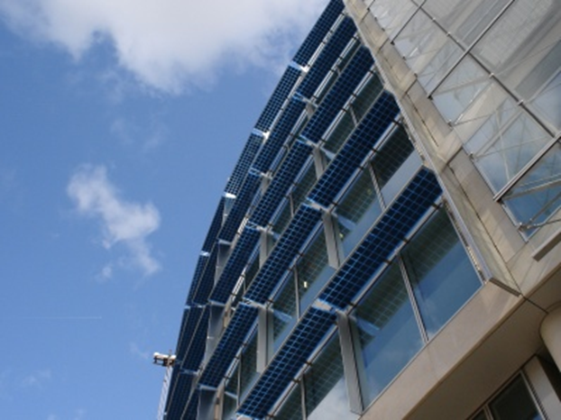
SOLAR SHADING
MURUR MIXED-USE COMPLEX
HAMAD ALRAHMANI
Cost Comparison:
- Total cost of 24 inch system:
$292,328
- Total cost of 18 inch system:
$128,310

Slide 19
SOLAR SHADING
MURUR MIXED-USE COMPLEX
HAMAD ALRAHMANI
Payback Comparison:
- The 24 inch system needs 10 years to payback the initial cost
- The 18 inch system needs less than 5 years to payback
Number of Years | Value of Savings at each Single Year | Total Value of Savings up to the Specific Year
1 | 35,183 | 35,183
2 | 33829.81 | 69,013
3 | 32528.66 | 101,541
4 | 31277.56 | 132,819
5 | 30074.58 | 162,894
6 | 28917.86 | 191,811
7 | 27805.64 | 219,617
8 | 26736.19 | 246,353
9 | 25707.87 | 272,061
10 | 24719.11 | 296,780
11 | 23768.37 | 320,549
12 | 22854.21 | 343,403
13 | 21975.2 | 365,378
14 | 21130 | 386,508
15 | 20317.31 | 406,825
Number of Years | Value of Savings at each Single Year | Total Value of Savings up to the Specific Year
1 | 29503 | 29503
2 | 28368.27 | 57871.27
3 | 27277.18 | 85148.45
4 | 26228.06 | 111376.5
5 | 25219.29 | 136595.8
6 | 24249.32 | 160845.1
7 | 23316.65 | 184161.8
8 | 22419.86 | 206581.6
9 | 21557.55 | 228139.2
10 | 20728.42 | 248867.6
11 | 19931.17 | 268798.8
12 | 19164.59 | 287963.3
13 | 18427.49 | 306390.8
14 | 17718.74 | 324109.6
15 | 17037.25 | 341146.8

Slide 20
SOLAR SHADING
MURUR MIXED-USE COMPLEX
HAMAD ALRAHMANI
Conclusion:
Solar shading saves a huge amount of energy
The two different sizes have small differences in energy savings, but big differences in cost
18 inch system saves less energy, but the payback is less than 5 years

Slide 21
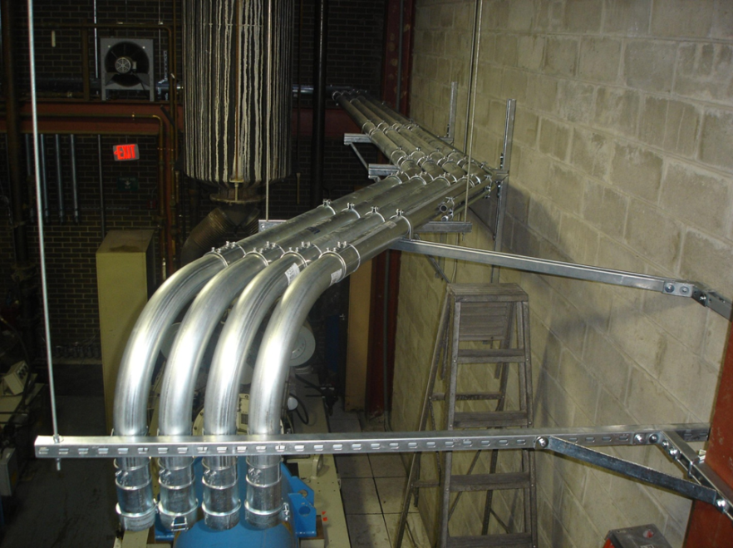
PREFABRICATION
MURUR MIXED-USE COMPLEX
HAMAD ALRAHMANI
Analysis 3: Prefabrication
Determining prefabrication benefits through:
Researching existing projects
Collecting information from industry experts
Applying prefabrication on Murur Project
Calculating prefabrication savings

Slide 22
PREFABRICATION
MURUR MIXED-USE COMPLEX
HAMAD ALRAHMANI
Truland Industries:
Information by Ian Foster:
On a recent job:
Receptacle boxes were prefabricated and accounted for only 5,000 hours which is 50% of the original time to complete the job
Also resulted in an overall labor saving of about 3%
Typically:
typical labor savings for the specific activity being prefabricated is 20%-30%
time saving can reach up to 50% of the original duration of the single activity that has been prefabricated

Slide 23
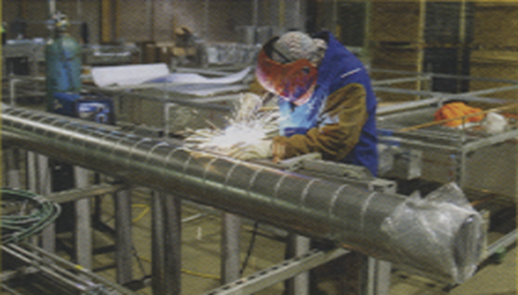
PREFABRICATION
MURUR MIXED-USE COMPLEX
HAMAD ALRAHMANI
Hospital Prefabrication Example:
Prefabrication process started midway through design development
178 patient rooms
120 corridor utility racks
18 workers in prefab shop, zero injuries
2 months off the schedule
2% off the cost
Bench-height work

Slide 24
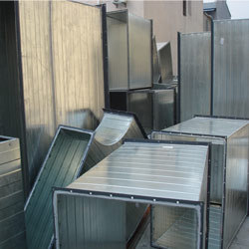
PREFABRICATION
MURUR MIXED-USE COMPLEX
HAMAD ALRAHMANI
Items to be Prefabricated:
- Receptacle boxes, fully assembled and ready to install
- Raceways and conduit racks for electrical wiring that are preassembled in one piece
- Ducts for ventilation, exactly measured so they can fit with no on-site adjustments
- Plumbing pipes, designed to fit perfectly taking ducts and raceways into consideration
- Conduits that are cut exactly as needed
- Pre-mounted electrical panels

Slide 25
PREFABRICATION
MURUR MIXED-USE COMPLEX
HAMAD ALRAHMANI
Prefabrication Savings:
25% time saving is being used for calculations
This prefabrication process can save the job 100 days
Less workers are needed to finish the same job, faster
Dollar value savings including revenue can reach over $3.8 Million
Description | Savings
Time (25% of total time of 400 days) | 100 days
Labor (50 x 50 days x 8hr/day x $8/hr) | $160,000
Cleaning and waste management (30% of $309,362 from GC estimate) | $92,808
More recycling material | No $ value
Expected revenue (100 days assuming 8% per year revenue) | 3,594,520
Total | $3,847,328

Slide 26
PREFABRICATION
MURUR MIXED-USE COMPLEX
HAMAD ALRAHMANI
Conclusion:
Prefabrication process must start at the beginning of a project
Many items can be prefabricated
100 days can be cut off the schedule of Murur Complex
Over $3.8 million can be saved on Murur project by prefabrication

Slide 27
CONCLUSIONS
MURUR MIXED-USE COMPLEX
HAMAD ALRAHMANI
Analyses Conclusions and Recommendations
Photovoltaic Panels:
Payback period of 75 years in unreasonable
Wait until cost is less, or until there are government incentives
Solar Shading:
18 inch louvers are the best choice
With less than 5 years to payback the cost, this is a must do
Prefabrication:
Benefits include:
-cost reduction, -less labor, -schedule cut, -waste management
With expected dollar value savings of $3.8 million, prefabrication is a must do

Slide 28


ACKNOWLEDGMENTS
MURUR MIXED-USE COMPLEX
HAMAD ALRAHMANI
Ali Moosa and Sons:
Especially to:
Engr. Ahmad Ali Moosa
Engr. Mohammed Saleh
Penn State AE department:
Especially to:
Professor Moses Ling
Professor M. Kevin Parfitt
Professor John Messner
Professor William Bahnfleth
My Friends:
Especially to:
Jaafar Al Aidaroos
Mohamed Alali
Samir Al Azri
Ian Foster (Truland Industries)
Everyone who had a part in helping me achieve what I did… Thank you

